Slide 1
Domain adaptation -- manifold transfer
Domain adaptation
Previous works
Manifold transfer
Experiments

Slide 2
Domain adaptation
Domain adaptation can be considered as a special setting of transfer learning which aims at solving a learning problem in the target domain by utilizing training data in the source domain, even when these domain may have different distributions [1].
The major problem is how to reduce the difference between the distributions of the source and target domain.
[1]S. J. Pan, I. W. Tsang, J. T. Kwok, and Q. Yang, “Domain adaptation via transfer component analysis,” IEEE Trans. Neural Netw., vol. 22, no. 2, pp. 199–210, 2011.

Slide 3
Previous works
Domain invariant transfer kernel learning[2]
Learning approach:
In order to require two datasets to follow similar feature-space distributions, it just suffices to require them to have similar kernel matrices.
The author adopts the idea of “Nystrom kernel approximation” to generate an extrapolated source kernel using the eigensystem of target kernel
[2]M. Long, J. Wang, J. Sun, and P. S. Yu, “Domain Invariant Transfer Kernel Learning,” IEEE Transactions on Knowledge and Data Engineering, vol. 27, no. 6, pp. 1519–1532, Jun. 2015.

Slide 4
Nystrom kernel approximation(一)
Nystrom kernel approximation approximates a new kernel by the extrapolates eigensystem of a target kernel.
k(z,x) is a continuous symmetric non-negative function which is positive semi-definite and square integrable w.r.t. distribution p(x).

Slide 5
Nystrom kernel approximation(二)
The idea of Nystrom method is to approximate the integral above by its empirical estimate:
K(z,x) is the cross-domain kernel matrix between Z (source domain) and X (target domain).

Slide 6
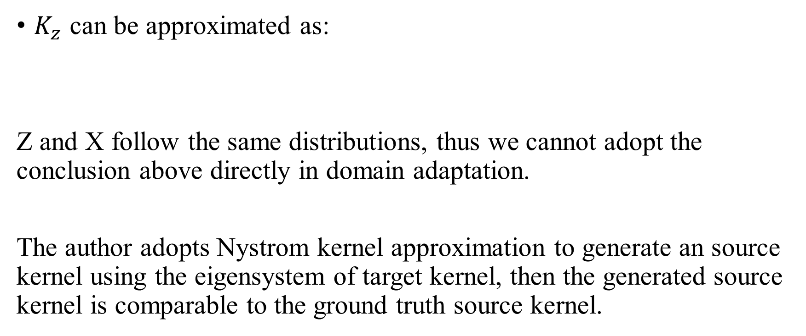
Nystrom kernel approximation(三)
$K_{z}$ can be approximated as:
Z and X follow the same distributions, thus we cannot adopt the conclusion above directly in domain adaptation.
The author adopts Nystrom kernel approximation to generate an source kernel using the eigensystem of target kernel, then the generated source kernel is comparable to the ground truth source kernel.

Slide 7
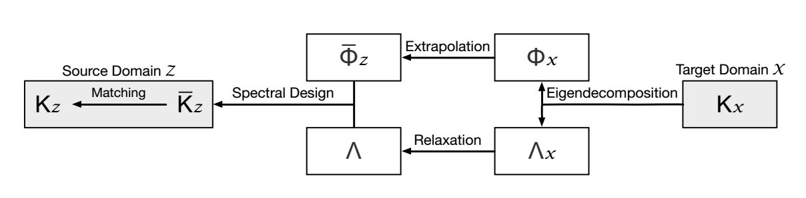
Previous works

Slide 8
Manifold transfer
Hypothesis:
If two datasets follow similar distributions, they should have similar manifold structure (source data Z and target data X).
Different from traditional domain adaptation assumption i.e., sufficient label information exists in source domain and few or none target labeled data are available in target domain, we focus on the case where few label information is available in source domain and only unlabeled data are available in target domain.

Slide 9
Manifold transfer
Learning approach:
Step1:
Step2:
Step3:
Relaxation Nystrom approximation

Slide 10
Manifold transfer
Step4:
Step5: manifold regularization:
Step6:

Slide 11
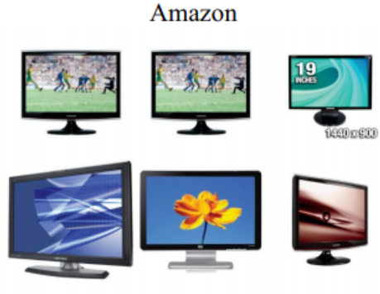
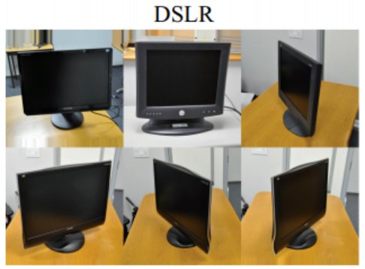

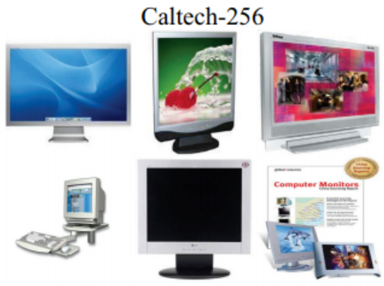
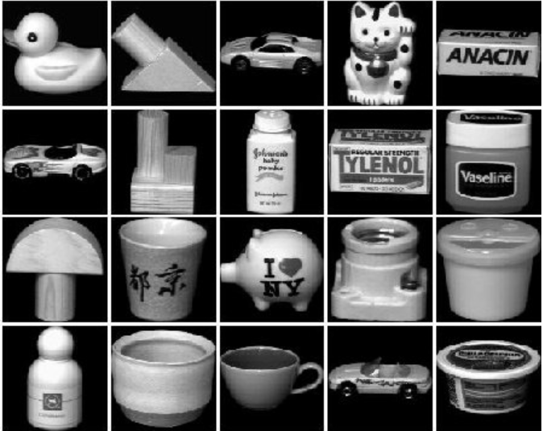
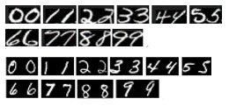
Experiments
Datasets : Office Caltech-256 COIL20 USPS MNIST
Reuters-21578

Slide 12
Experiments
Dataset | Type | Examples | Features
USPS | Digit | 1800 | 256
MNIST | Digit | 2000 | 256
COIL20 | Objects | 1440 | 1024
Office | Objects | 1410 | 800
Caltech | Objects | 1213 | 800
orgs | text | 1237 | 4771
people | text | 1208 | 4771
place | text | 1016 | 4771

Slide 13
Experiments
Comparison methods:
Transfer Component Analysis (TCA);
Transfer Kernel Learning (TKL);
Geodesic Flow Kernel (GKL) [3];
RLS
LapRLS
[3] Boqing Gong, Yuan Shi, Fei Sha, and K. Grauman, “Geodesic flow kernel for unsupervised domain adaptation,” in 2012 IEEE Conference on CVPR, 2012, pp. 2066–2073.

Slide 14
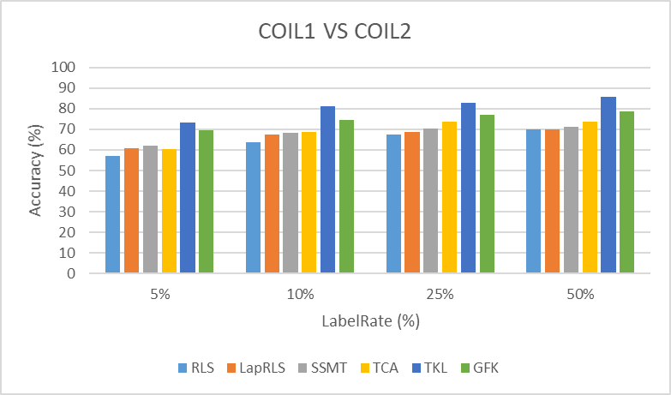
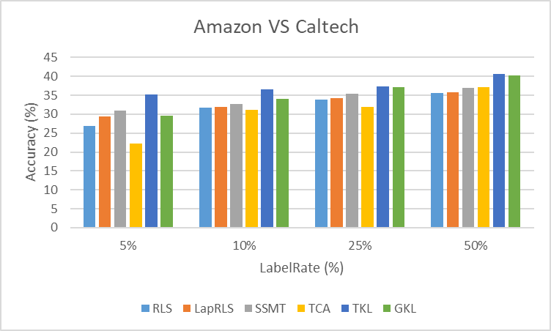
Experiments
COIL20 A vs C

Slide 15
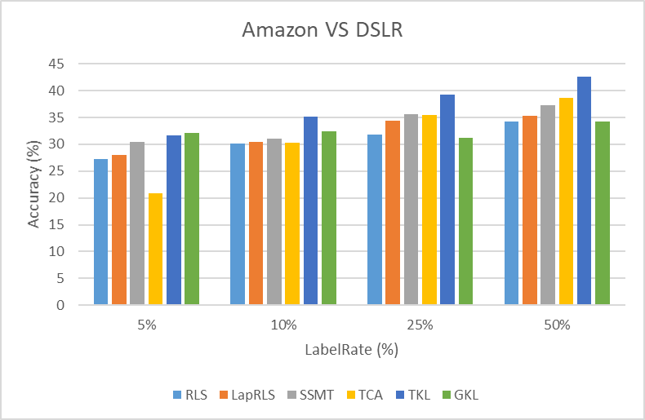
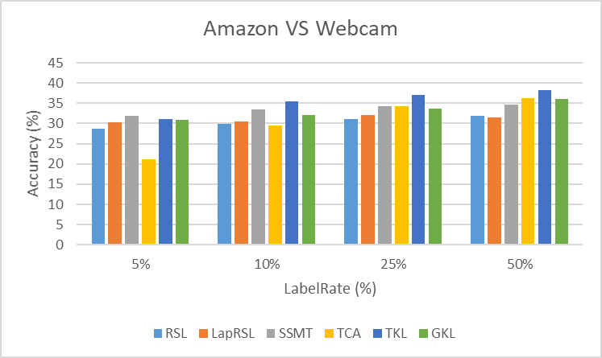

Slide 16
Distribution mismatched
The relationship between data changed
Adjust the weight between data

